Slide 1
It always seems impossible until it's done.
- Nelson Mandela

Slide 2

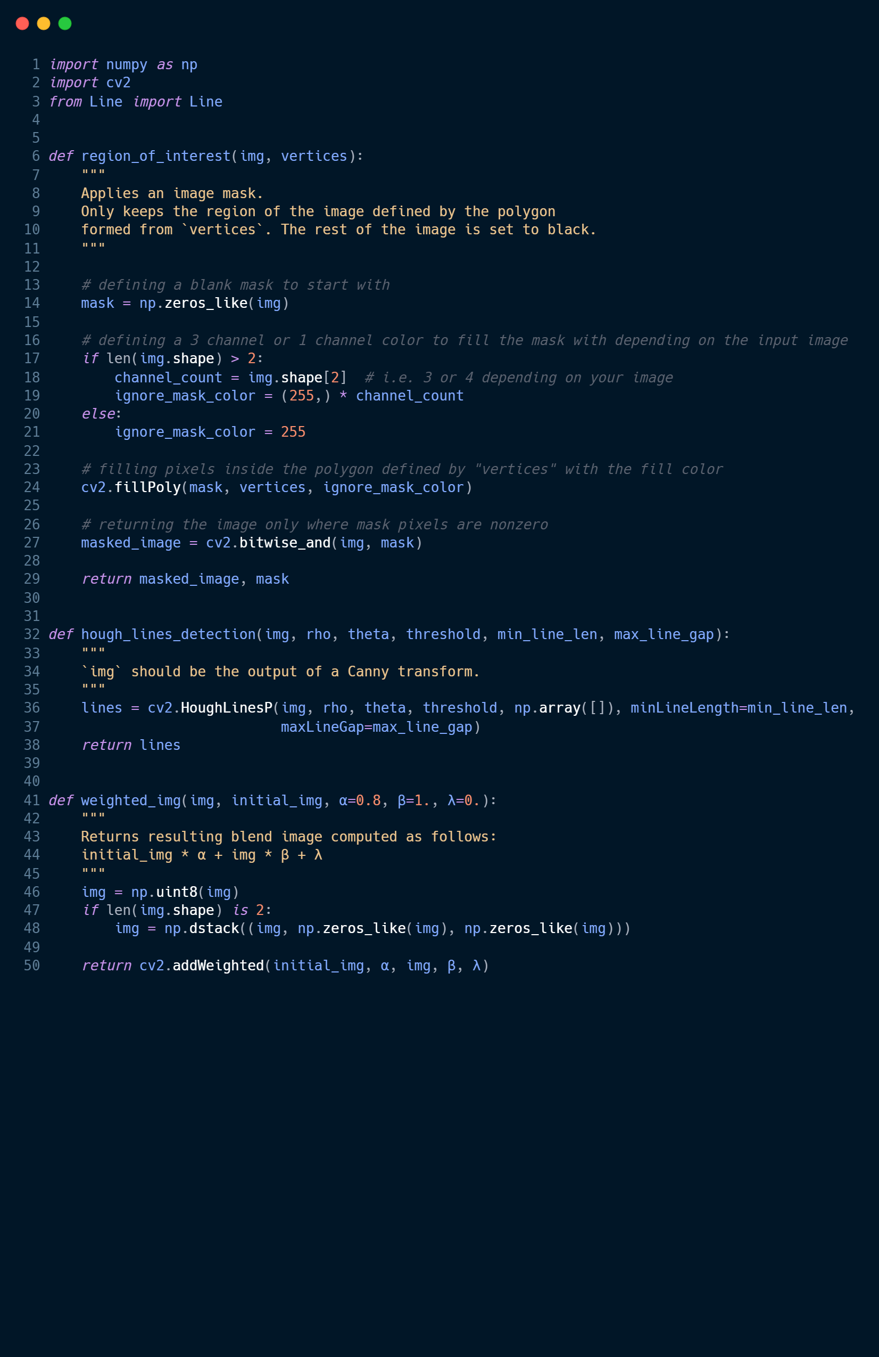

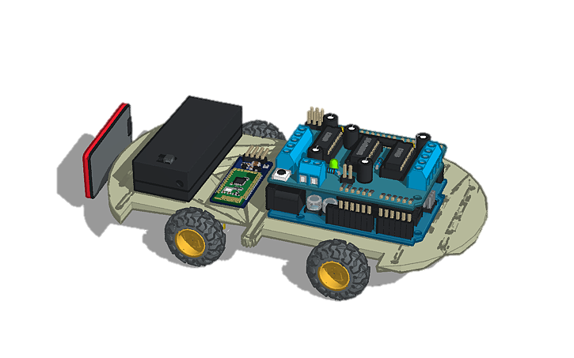
BRAINLY
Vehicle With A Brain
Manish Pandey
Sahil Prajapati

Slide 3
Table of contents
Introduction
Reasearch
Design Process
Future Plan
Methodologies
Conclusion

Slide 4
Introduction
1
Let’s get to know Brainly better

Slide 5
Introduction
What?
A lane detection system integrated with self driving car
How?
Using the power of python and arduino
Why?
To grasp concept of deep learning and computer vision
Do-able?
Yes!!

Slide 6

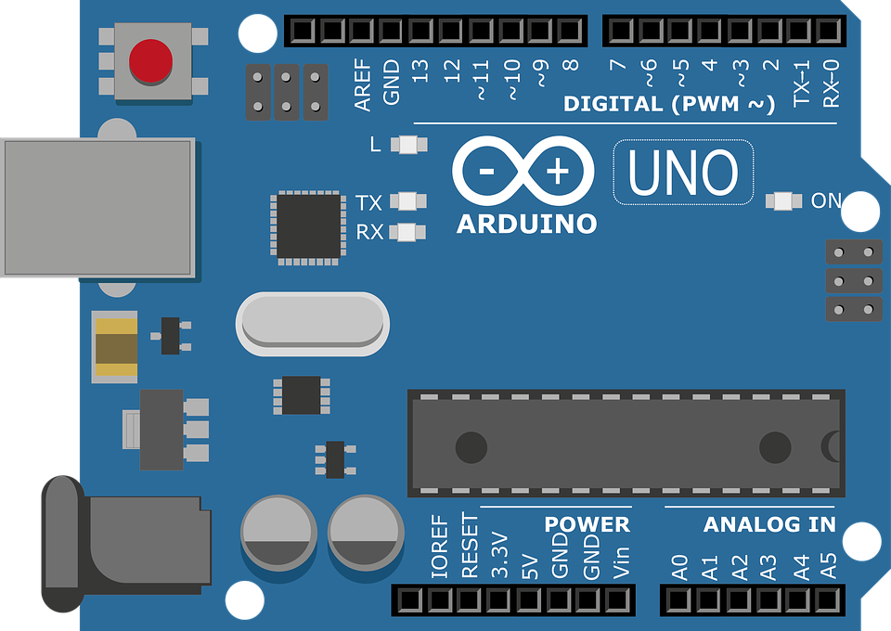

Technology we’ll be using
Python
01
Lane detection and control signals
Arduino Uno
02
Controlling the physical system
Bluetooth & Network
03
Transmitting Signals and real-time video

Slide 7
PROBLEM VS SOLUTION
PROBLEM
SOLUTION
Latecy Issues
NN Module Bugging out
Using onboard Rasberry Pi
Training model using deep learning

Slide 8
Design Process
2

Slide 9
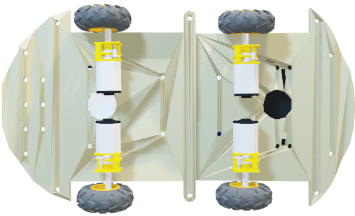
Layered Architecture of Hardware
01
The First Layer
The base for the system and where everything rests on.
Consists of the chassis, motors and wheels

Slide 10
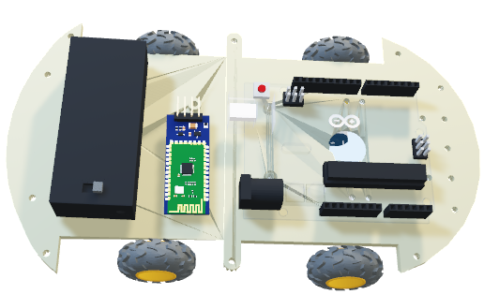
Layered Architecture of Hardware
01
The First Layer
The base for the system and where everything rests on.
Consists of the chassis, motors and wheels
02
The Second Layer
The microcontroller, power source and the HC-06 BT module

Slide 11
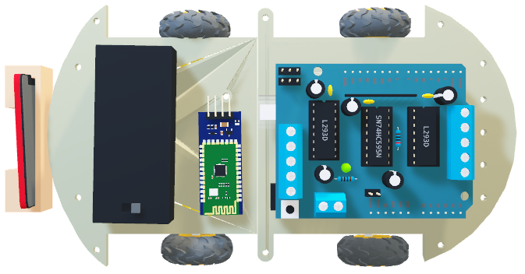
Layered Architecture of Hardware
01
The First Layer
The base for the system and where everything rests on.
Consists of the chassis, motors and wheels
02
The Second Layer
The microcontroller, power source and the HC-06 BT module
03
The Third Layer
This is where L293D Motor Driver shield is mounted on arduino

Slide 12
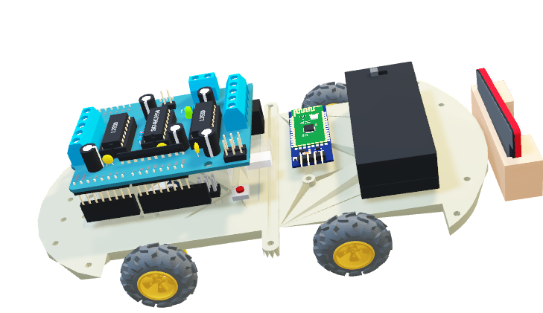
The Final System

Slide 13
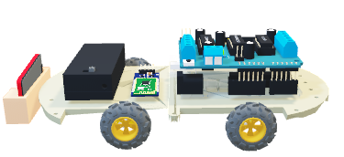
The Final System
Arduino Uno and jumper wires
1
2
TT Motors and wheels
L293D Motor Driver Shield
3
4
Smart Camera Device
HC-06 / HC-05 Bluetooth Module
5
6
Power Supply

Slide 14
Software Architecture
Arduino Control System
BT Communication System
Lane Detection System
Camera Feed Transmission system

Slide 15
System Work Flow
Connect BT and Camera Module
Process and analyze camera feed
Transmit the signal to HC-06 BT module
Control the Arduino system based signal

Slide 16
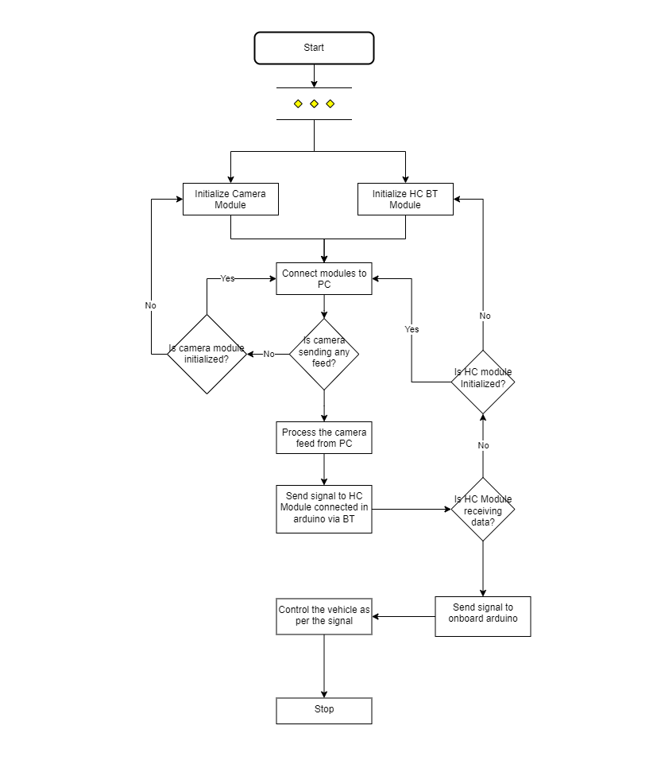
System Work Flow
Detailed view of the system flowchart

Slide 17
Methodologies
3

Slide 18
Why prototype model?
Large Project
Brainly, for us, is a large project with numerous minor and major functionalities. It requires a lot of testing and tuning both the AI and the hardware to make it perfect.
Frequent prototype development
Being a large project, we will have to create and train model multiple time. The model must be created with base functionality and later on, developed into something we are aiming to achieve.

Slide 19
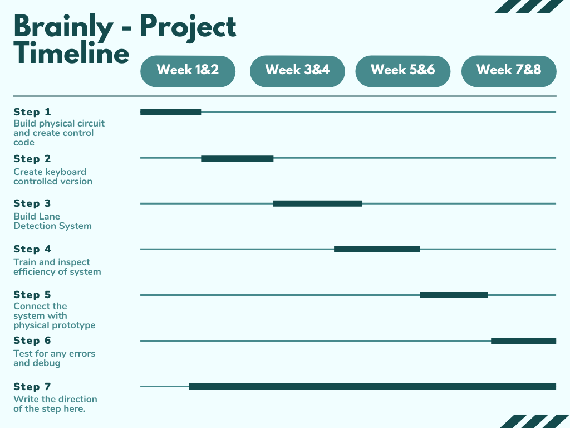

Slide 20
Research & Analysis
4

Slide 21
Feasibility Study
01
Python, Arduino IDE and all hardware are easy to come across
Technical
02
Project can be completed with minimal possible cost
Economic
03
Just a click of button and the project will run (or should I say drive)
Operational
04
The model can be built and trained in span of ~8 weeks
Time

Slide 22
SWOT Analysis
Strength
S
Every piece of technology used is easy to come by
Weakness
W
We have to learn new technology and integrate it in less time
Opportunity
O
Skill development and learning new technology
T
Threats
System failure and AI Bug

Slide 23
What next?
5
Future Plans!

Slide 24
Future Plans and Scope
Traffic Light Detection
Pathfinding
Algorithm
Vehicle
Detection
Obstacle
Avoidance
Pedestrian Detection
Progress
Tracking

Slide 25
Conslusion!
6

Slide 26
Expected Outcomes
Effectively transmit camera feed and analyse it using the Lane Detection System
Based on the result of lane detection, send signals to HC-06 Bluetooth Module
Transmit the signal to Arduino and L293D Motor Driver shield
Control theTT Motors using the system and successfully drive, following the lane

Slide 27
Thank You!
Any questions?

